Slide 1
Irkutsk National Research Technical University
Institute of Information Technology and Data Analysis
Development of a registration subsystem for events via mobile devices for the information system "Rating of students"
Speaker: Daniil Vovikov
Tutors: Evgeny Cherkashin
Sinaida Bakhvalova
Mikhail Katashevtsev
Notes:
Hello! I am Daniil Vovikov, a fourth-year student at the Irkutsk National Research Technical University. Topic of my presentation: Development of a registration subsystem for events via mobile devices for the information system "Rating of students"
Please ask questions at the end.

Slide 2

Presentation plan
1
Introduction
2
Main part
Purpose of the work
Implementation methods
Tasks
Results
3
Future prospects
4
List of sources used
Notes:
In my appearance, possible points will be touched upon.
In the introduction, a few words about the subsystem as a whole.
In the main part - the problem we are solving, tasks, solutions and results.
In conclusion, let's talk about upcoming system updates.

Slide 3


Introduction
The rating system is a complex mechanism that affects many aspects of a student's life
3
Notes:
So what is this system? The university has a rating scholarship - a scholarship that rewards students for their success in five areas: study, science, sports, cultural and social activities. Events held both inside and outside our university are one of the ways to earn points for this scholarship. The problem is that attendance at events is recorded manually.

Slide 4

Purpose of the work
To optimise the mechanism for conducting events
4
Notes:
Therefore, we are developing an updated system that can facilitate the organization of events at the university. A part of this system is the registration subsystem for events, which is a mobile application.

Slide 5

Tasks
1
Research and analysis of current processes
2
Simulation of the updated system
3
Development of GUI layouts
4
Application development
5
Notes:
To accomplish this task, we set the following tasks:
Explore and analyze the system in its current state.
Present the concept of the updated subsystem.
Design interface layouts for the future application.
And create the application itself.

Slide 6
Methods
1
3
Selection of code libraries for work
IDEF0
2
4
Create an application architecture
USE-CASE
Notes:
To solve problems related to the design of the future subsystem, we used the following tools:
The IDEF0 notation is for creating sets of business processes.
USE-CASE - for working out scenarios for using the application.
To create an application, we have selected the necessary technologies and code libraries.
and created a mobile app architecture

Slide 7
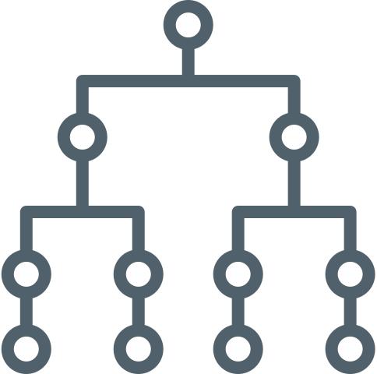
Methods
USE-CASE
IDEF0
system use cases
Current state diagram
Create an application architecture
Future state diagram
System architecture
Notes:
Using the IDEF0 notation, we created business models for the current and future representation of processes.
With the help of USE-CASE, the processes of using the application were described.
We also created the system and application architecture.

Slide 8
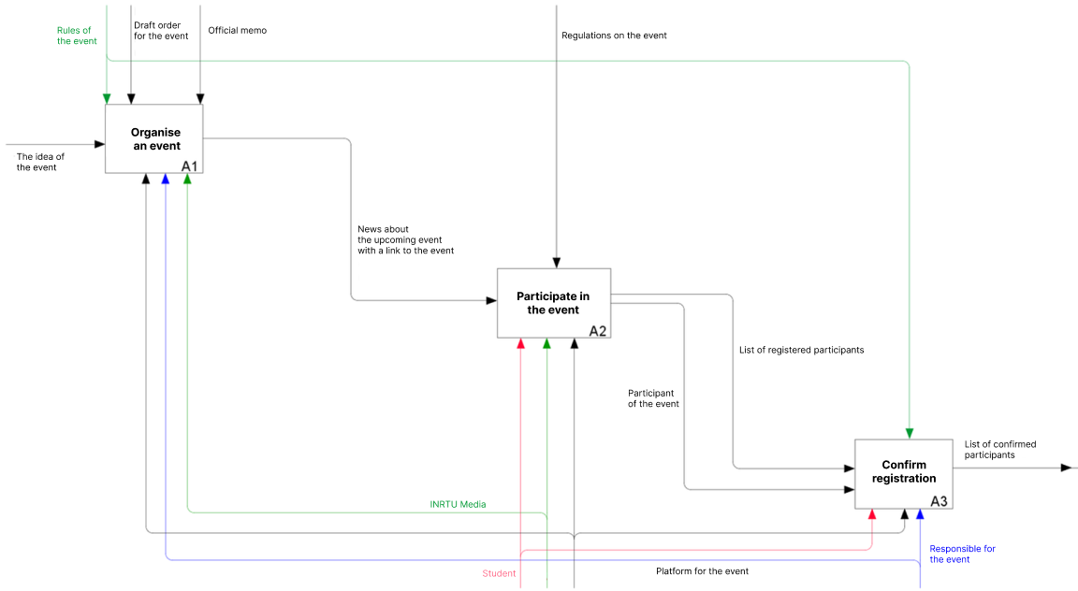
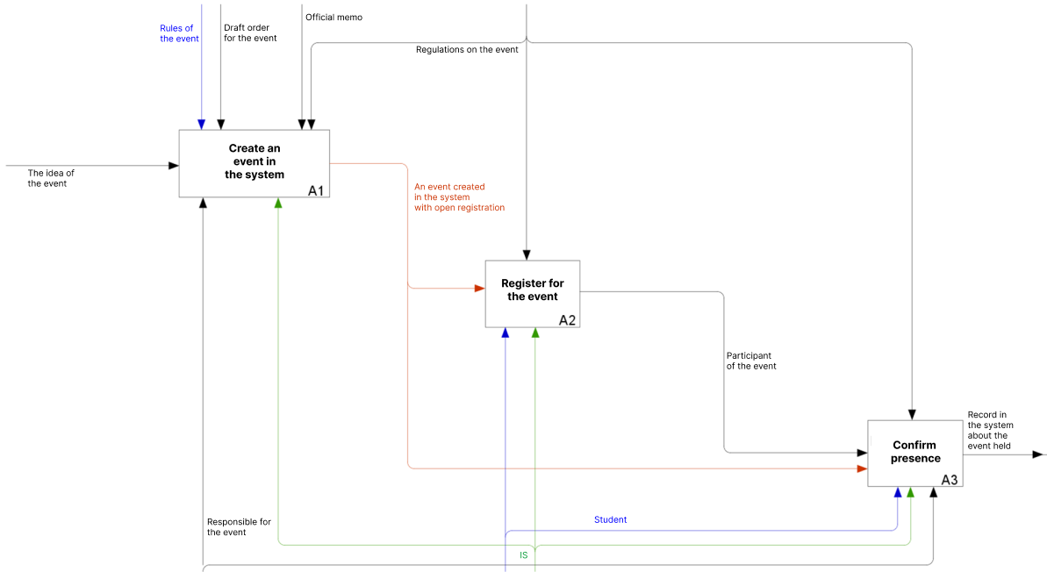
IDEF0 Notation
Notes:
This slide presents the business processes of the current and future state of the system. The future representation of the system consists of three blocks: Create an event in the system, Register for the event, Confirm presense.
In the first block, the responsible person creates an event in the system.
In the second block, students register for the event.
In the final block, confirmation of the presence of students at the event is carried out.

Slide 9
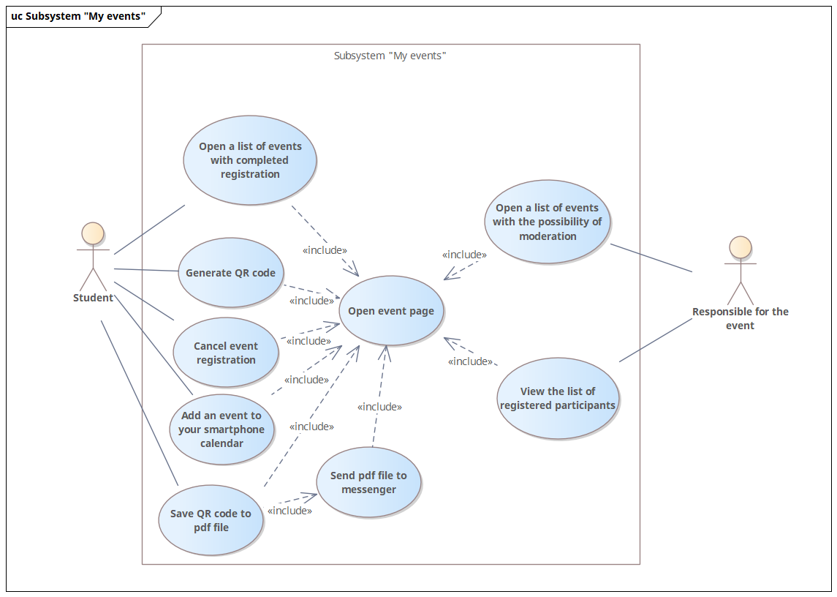
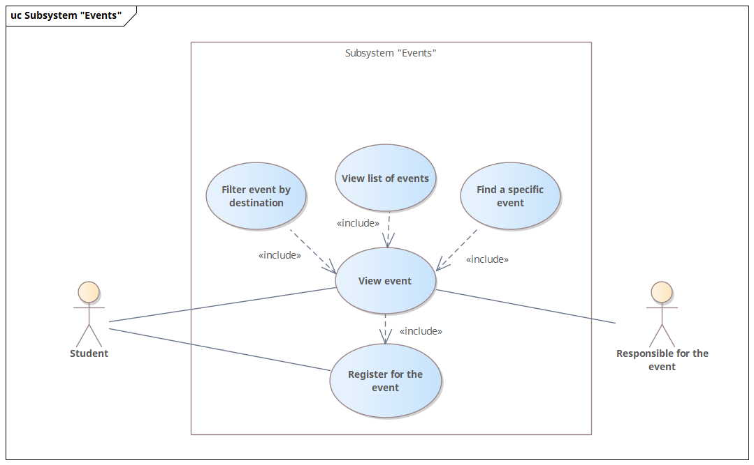
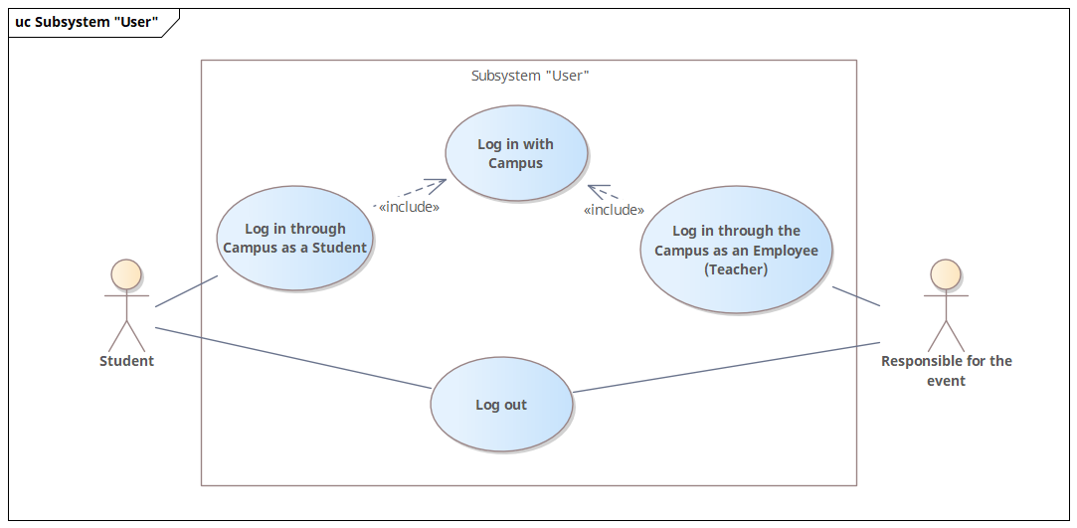
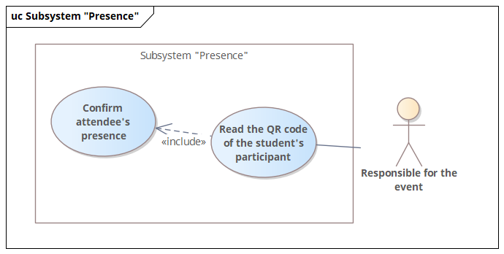
Use-Case diagram
Notes:
A use case diagram is a set of actions available to custom entities allocated in the system. We have identified two entities: the student and the person responsible for the event.

Slide 10
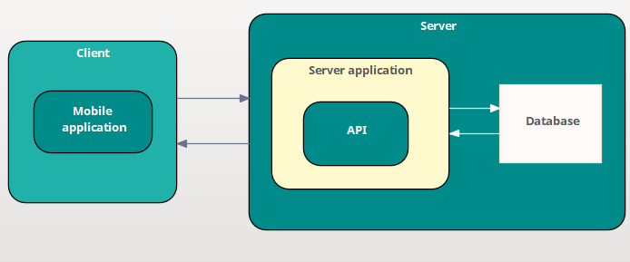
System architecture
10
Notes:
This slide shows the architecture of the system: the mobile application interacts with the server part of the system, which sends responses from the database.

Slide 11

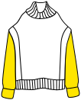
Results
Interface layouts
Mobile Application
Notes:
At the current stage of development, we have: interface layouts and a prototype of a mobile application.

Slide 12
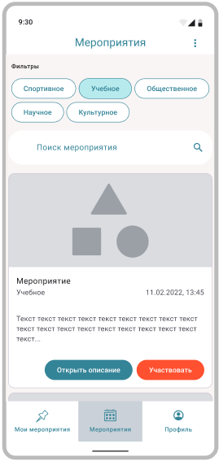
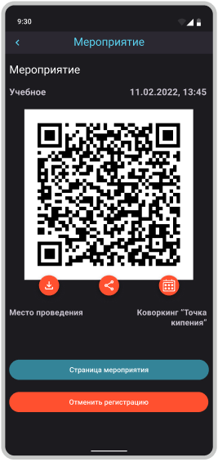
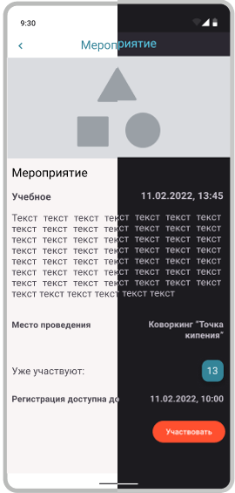
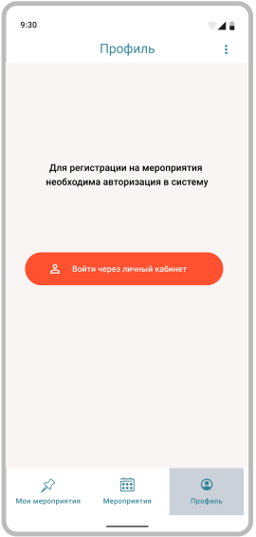
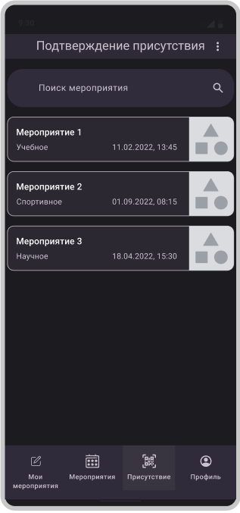
12
Notes:
This slide shows a prototype of a mobile application. A student can log in to it, sign up for an event and receive a QR code to confirm their presence. The person in charge reads the QR code using the application and thus confirms the presence.

Slide 13



Future prospects
1
To complete the software implementation
2
To test the application
3
To connect the application to the system API
13
Notes:
The following points can be singled out as a reserve for the future:
Finish developing a mobile application.
Test the mobile app.
Set up integration with the system API.

Slide 14
Sources
1
INRTU - Rating – URL: https://www.istu.edu/studentu/stipendiya/reyting (date of access: 15.03.2023).
2
Figma Help Center – URL: https://help.figma.com/hc/en-us (date of access: 14.02.2023).
3
Material Design – URL: https://m3.material.io/ (date of access: 10.01.2023).
4
Kotlin Programming Language – URL: https://kotlinlang.org/ (date of access: 10.01.2023).
14
Notes:
This slide contains a list of sources used.

Slide 15
Irkutsk National Research Technical University
Institute of Information Technology and Data Analysis
Development of a registration subsystem for events via mobile devices for the information system "Rating of students"
Speaker: Daniil Vovikov
Tutors: Evgeny Cherkashin
Sinaida Bakhvalova
Mikhail Katashevtsev
Notes:
Do you have any questions?

